Slide 1
Analysis of Last Words of Death Row Inmates
Stephen Hoover, Obusom Okafor, & Varun Pillai

Slide 2
Key Questions
What is on the minds of inmates during their last moments?
Anger? Regret? Sadness? Love?
What other factors could affect sentiment?
Age
Race
Decade
Can we determine the stage of grief an inmate is in based on their last statements?

Slide 3
Key Questions
Why is this important?
Death row inmates suffer no consequences for what they have to say
No parole, extended prison time, etc.
This provides a situation where inmates have no incentive not to be truthful about their feelings
Additional studies could be done to extrapolate results to the general prison population
Compare to recidivism rates
Compare to sentiment analysis of parole statements

Slide 4
Data
Texas Department Of Criminal Justice maintains records of all executions.
Provides last words, age, race, date, county and other offender information. All data is public record.
Analysis of the last words allows us to determine the emotions and sentiment of prisoners.

Slide 5
Methodology
Removed “no statement” records
Expanded stop list
Many common words skewed data
Be, thing, cause, “ya”, etc.
Synonym Lists
Developed in filter viewer
Focused on family terms and religious terms
Multi-word Terms
“Not guilty”, “I am innocent”, “innocent man”
Thousands of terms pared down to 63 total positive/negative terms for sentiment analysis.

Slide 6
Methodology
Sentiment Analysis variables in the Text Topic node.
Re-weighted certain terms due their applicability to our dataset
Ran multiple versions
High number of multi-terms
Low number of single terms
Stages of Grief
Used start list to parse documents with commonly used words associated with different stages of grief
Filtered to determine the relative frequency of each stage
Inductive Approach
Ran many iterations of multiple models to better understand the data
Spiral model

Slide 7
Analysis Results
Mostly positive tones (266 Docs)
Love for family and friends
Apologies/remorse
Religion
Love for life
Some negative tone (52 Docs)
Declaring innocence
Hate for police/justice system

Slide 8
Positive Tones
Most documents overwhelmingly positive
Most inmates showed great remorse
Wanted to tell their families how much they love them, to stay strong, etc.
Religion
Majority of documents mention God and religion
These terms seem to be correlated almost exclusively with positive toned documents

Slide 9
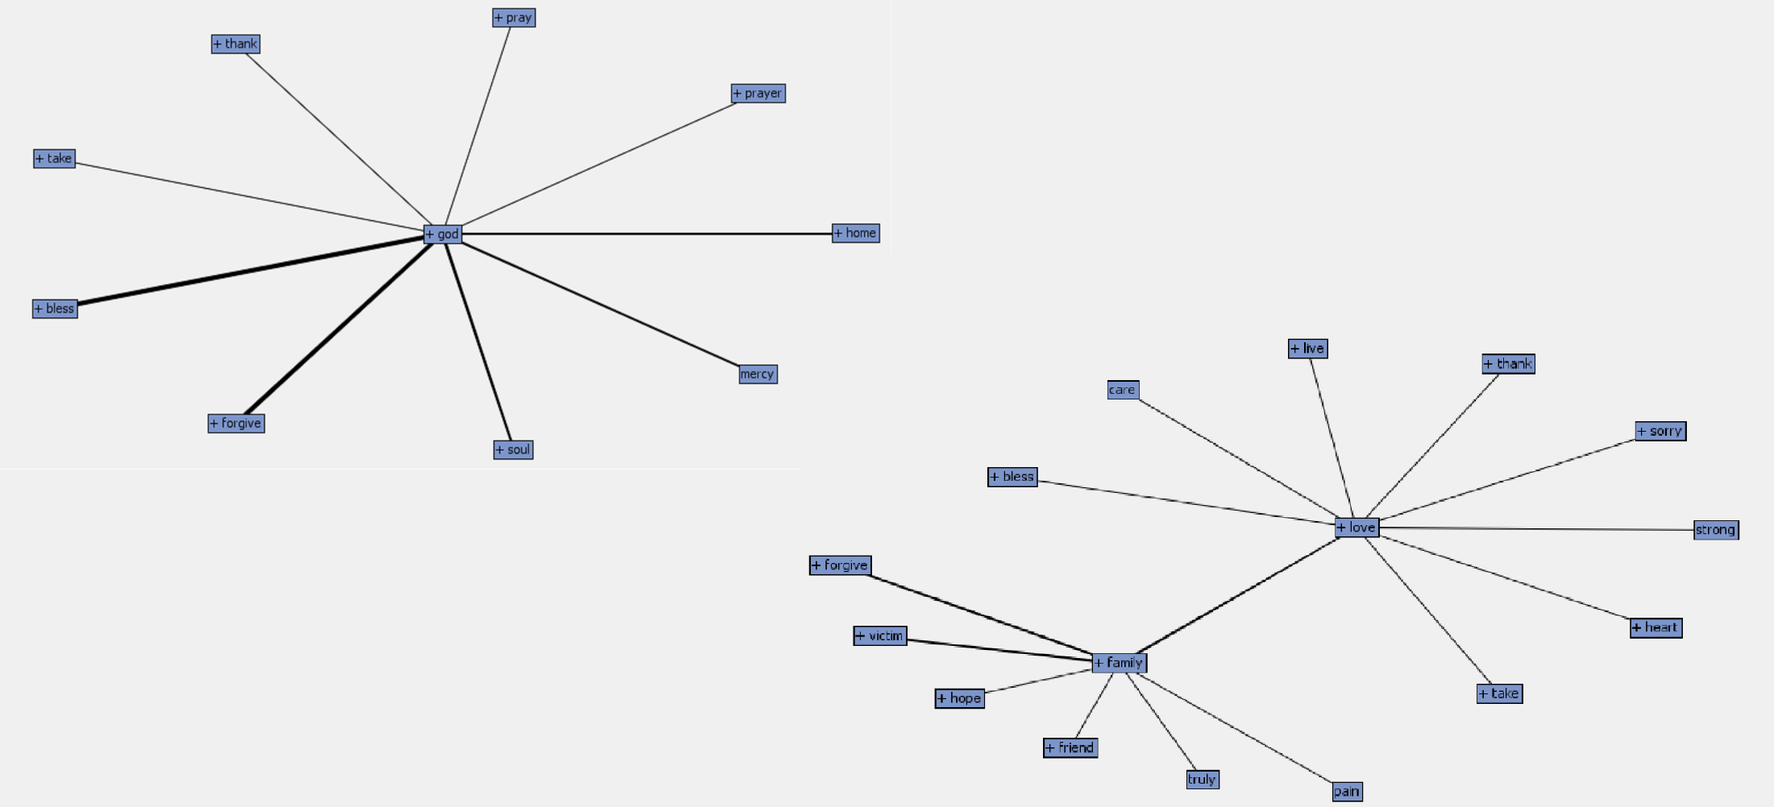

Slide 10
Negative Tones
Negative model includes those that maintain innocence as well as unhappiness with prison/justice system
Surprisingly low number of negatively toned comments compared to expectation
Possible reasons for low negative tones:
Prison system successfully rehabilitates prisoners
Prisoners are more likely to become religious, which is associated with positive statements

Slide 11
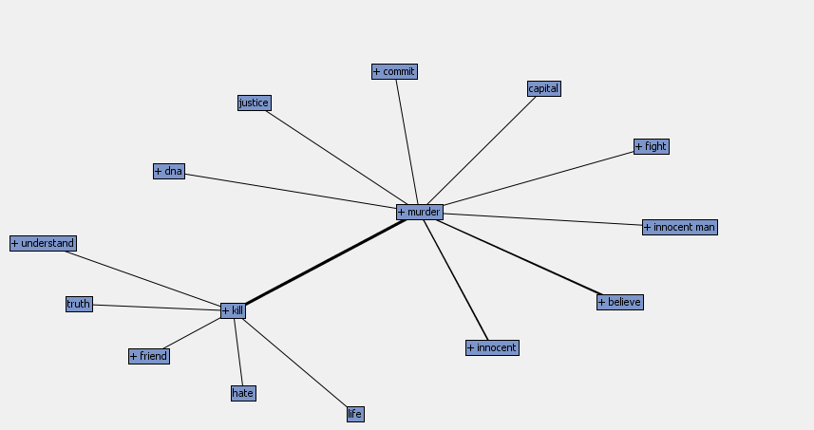

Slide 12
Race
White inmates made negatively toned statements more often than black inmates and nearly three times as often as Hispanic inmates
Whites and blacks both declare innocence at relatively equal frequencies
Hispanic prisoners unlikely to maintain innocence or make negative statements

Slide 13
Age
Teenage convictions and prisoners executed in the 21-35 age band were more likely to reject their sentence and give negatively toned last statements.
As age increased past the youngest band we saw a significant decrease in negatively toned statements

Slide 14
Decade
Rising and falling trends in tone by decade.
Cannot determine underlying cause in this trend
May be coincidental and due to the somewhat low sample size of negatively toned comments
Possible Explanations:
War on Drugs?
Prison overcrowding?
Other cultural factors?

Slide 15
5 Stages of grief analysis
Based on our previous sentiment analysis, we expected to find most people in acceptance.
We excluded stage 1 (denial) and stage 4 (depression) from our analysis. We were not able to parse any documents with these themes.
Stage 2 (Anger)
Few results in this stage: 7 terms over 22 documents correlated with anger
Stage 3 (Bargaining)
5 terms over 33 documents.
This stage is associated with regretting their actions and wishing for a second chance at life.
Stage 5 (Acceptance)
Majority of documents fell into this stage of the model.
Associated with acceptance of actions and consequences, remorse for said actions, and apologies to those who were hurt.

Slide 16
Conclusion
We have the following observations based on the Text Mining:
Prison seems to have a positive effect on death row inmates
Most find solace in religion which, in turn, seems to affect their thoughts and behaviors in a positive way
Inmates tend to feel remorse for their actions and wish for forgiveness from the victim or victim’s family, their family, and society. They accept the consequences of their actions
Death row inmates, though they have committed heinous crimes, are still human. They love and miss their families, and experience the range of human emotions.
As a follow up, we could try to find the effect of the following on our results:
The period of time an inmate spends in the prison before being executed
Combine the socio-economic data in the counties along with the convictions to find patterns in general
Compare sentiment in parole hearings for non-death row violent offenders to see judge expected recidivism of parolees
Determine the most successful underlying causes of criminal rehabilitation and extrapolate that to other institutions

